Slide 1

Nurse Attrition Analysis and Strategic Retention Plan Data-Driven Insights and Actionable Recommendations

Slide 2



Agenda
Project Overview
Importance of Addressing Attrition
Data Overview
EDA Summary
Analysis Findings
Root Cause Analysis
Proposed Retention Strategies
Monitoring and Evaluation Plan
Case Studies
Conclusion and Next Steps

Slide 3

Nurse turnover: Understand it, Reduce it What can employers do to increase nurse retention? https://www.myamericannurse.com/wp-content/uploads/2020/08/an8-Turnover-728.pdf

Slide 4

Project Overview
Objective:
Analyze data to identify factors contributing to nurse attrition and propose retention strategies.
Deliverables:
Data Analysis Report
Retention Strategy Plan
Monitoring and Evaluation Plan

Slide 5

Importance of addressing nurse attrition
Impact of Attrition:
Financial: Recruitment and training costs.
Operational: Increased workload for remaining staff.
Patient Outcomes: Reduced quality of care.

Slide 6

Dataset Details:
Columns: OverTime, MonthlyIncome, JobSatisfaction, WorkLifeBalance, YearsAtCompany, Department, Attrition. JobRole, EducationLevel,
Scope: Organization-wide data for the past year.
Key Metrics Analyzed:
Nurse Attrition Rates by Workload, Compensation, Tenure, Education Level, and Department etc.,
Data Overview

Slide 7
EDA SUMMARY
Attrition Trends:
Overall nurse attrition rate: 13.0%.
Highest attrition among new hires (first-year attrition: 41.7%).
Departmental disparities, with Maternity showing the highest attrition rate (14.5%).
Root Causes:
Workload and Burnout:
Attrition rate for nurses working overtime: 32.6%.
Compensation:
Low-income nurses experienced 26.6% attrition, compared to 8.1% for high-income nurses.
Career Growth:
Bachelor’s degree holders had a higher attrition rate (15.6%) than Master’s degree holders (11.5%).
3. Satisfaction Metrics:
Low satisfaction scores strongly correlated with higher attrition.
Departments with better managerial support showed lower turnover.
4. High-Risk Groups:
Nurses in the 0–1 year tenure group.
Departments with heavy overtime schedules.

Slide 8
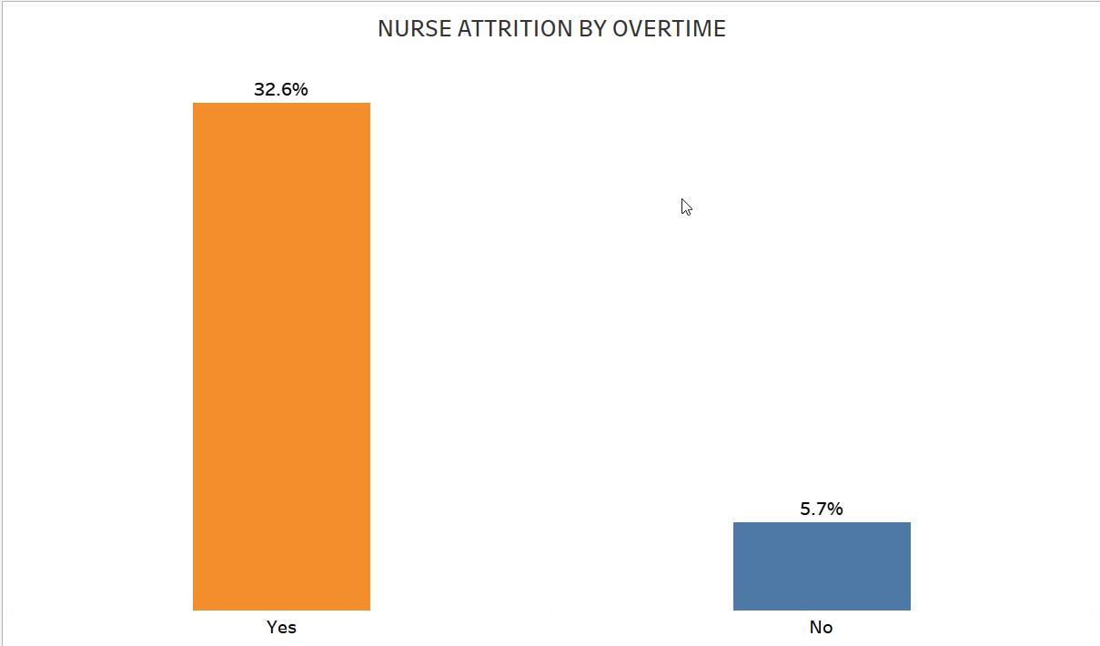
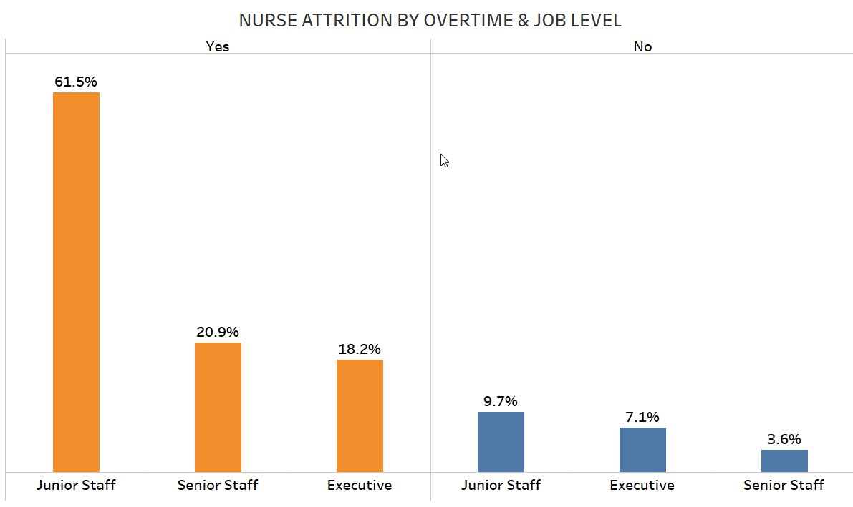
Analysis Findings:
Workload and Burnout
Key Insights:
Nurses working overtime: 32.6% attrition rate.
Junior nurses working overtime: 22.7% attrition rate.
Implications:
Workload imbalance leads to burnout.

Slide 9
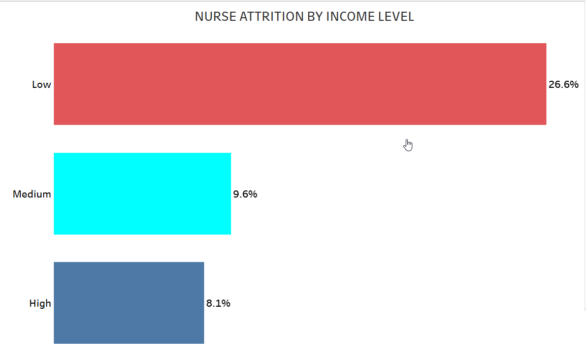
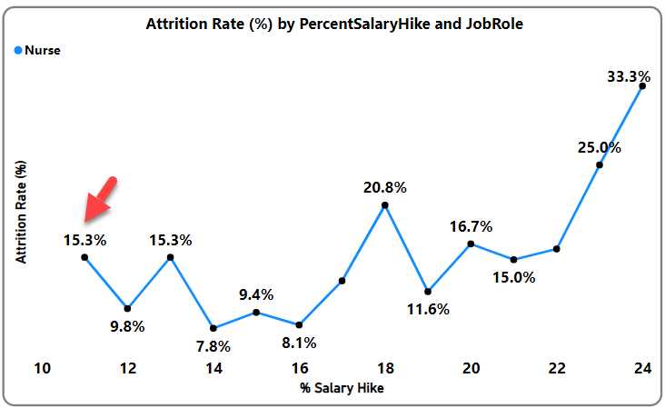
Analysis Findings:
compensation
Key Insights:
Low-income nurses: 26.6% attrition rate.
Salary hikes (15.3%) alone did not significantly reduce attrition.
Implications:
Compensation strategies must address broader dissatisfaction

Slide 10
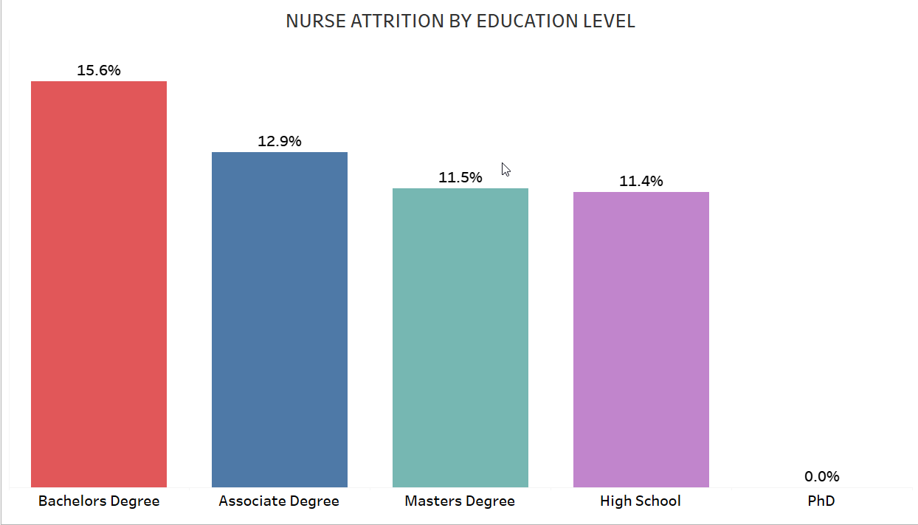
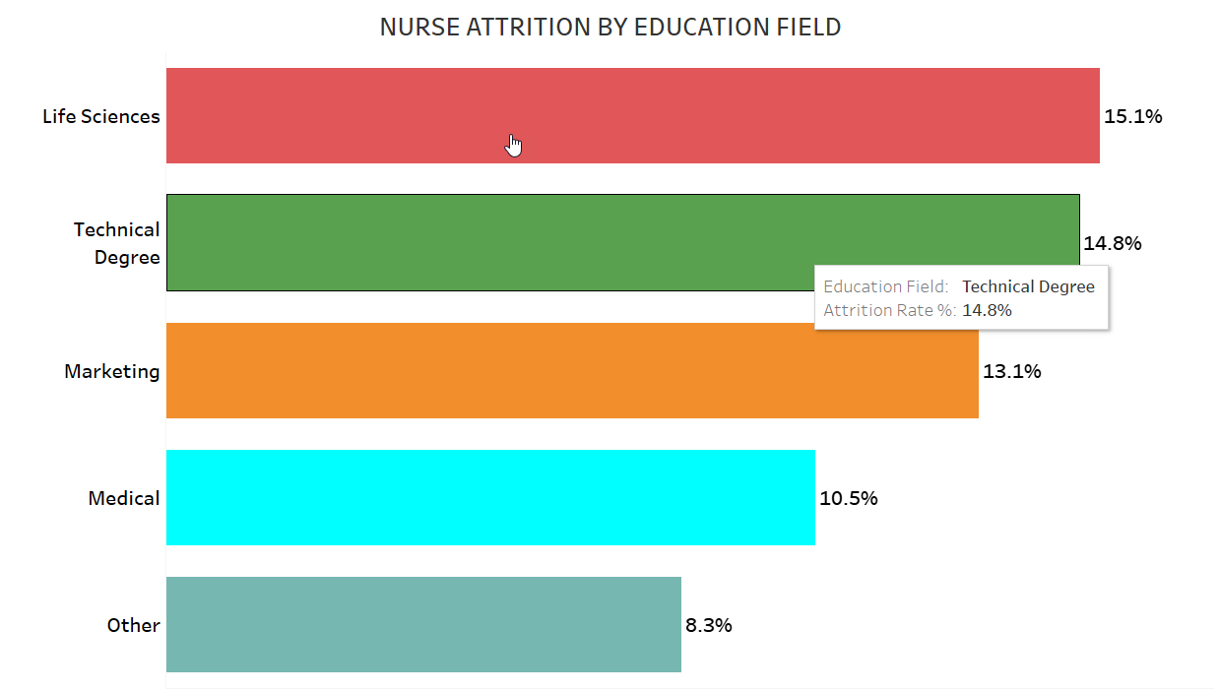
Analysis Findings:
Career Growth and Satisfaction
Key Insights:
Nurses with Bachelor’s degrees: 15.6% attrition rate.
High performers leaving due to limited advancement opportunities.
Implications:
Structured career paths and leadership opportunities are critical.

Slide 11
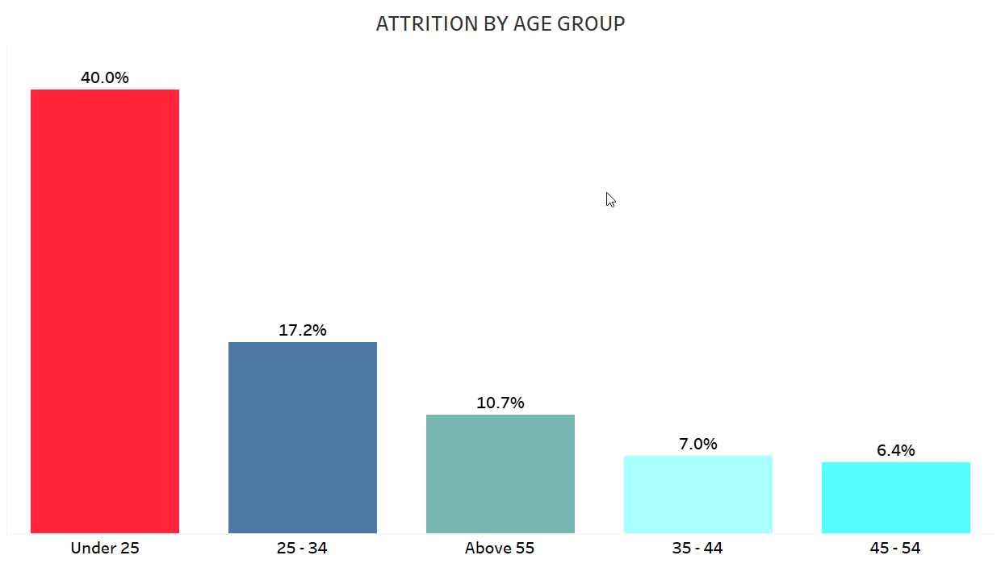
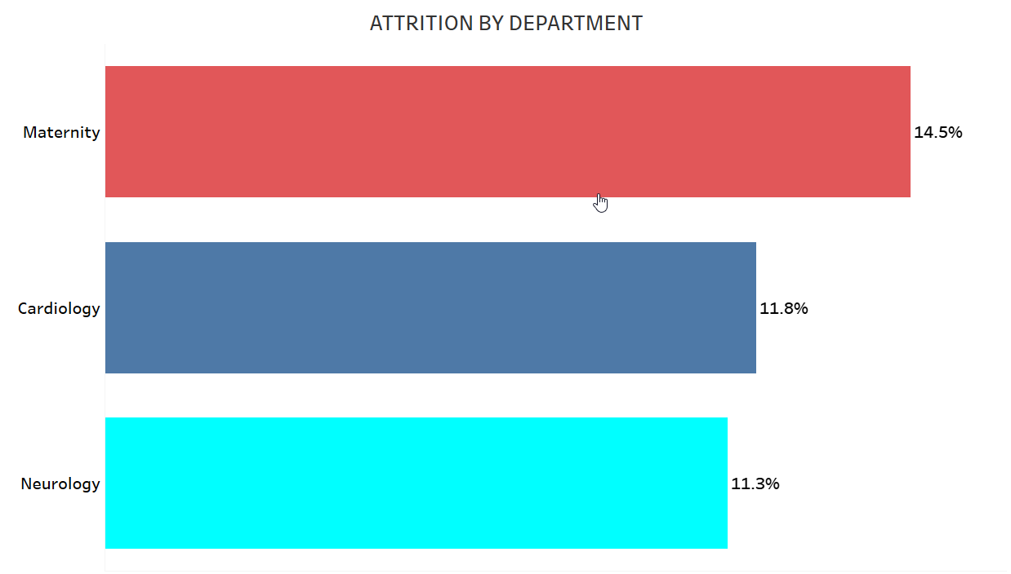
Analysis Findings:
Attrition Trends
High-risk Segments
Younger nurses (Under 25), first-year employees, and nurses in the Maternity Department are at the highest risk of attrition.
Role of Leadership
Strong managerial relationships significantly influence retention, highlighting the importance of leadership development.
Professional Growth
Training and career progression are critical factors in reducing turnover, as seen in the correlation between training sessions and attrition rates.

Slide 12
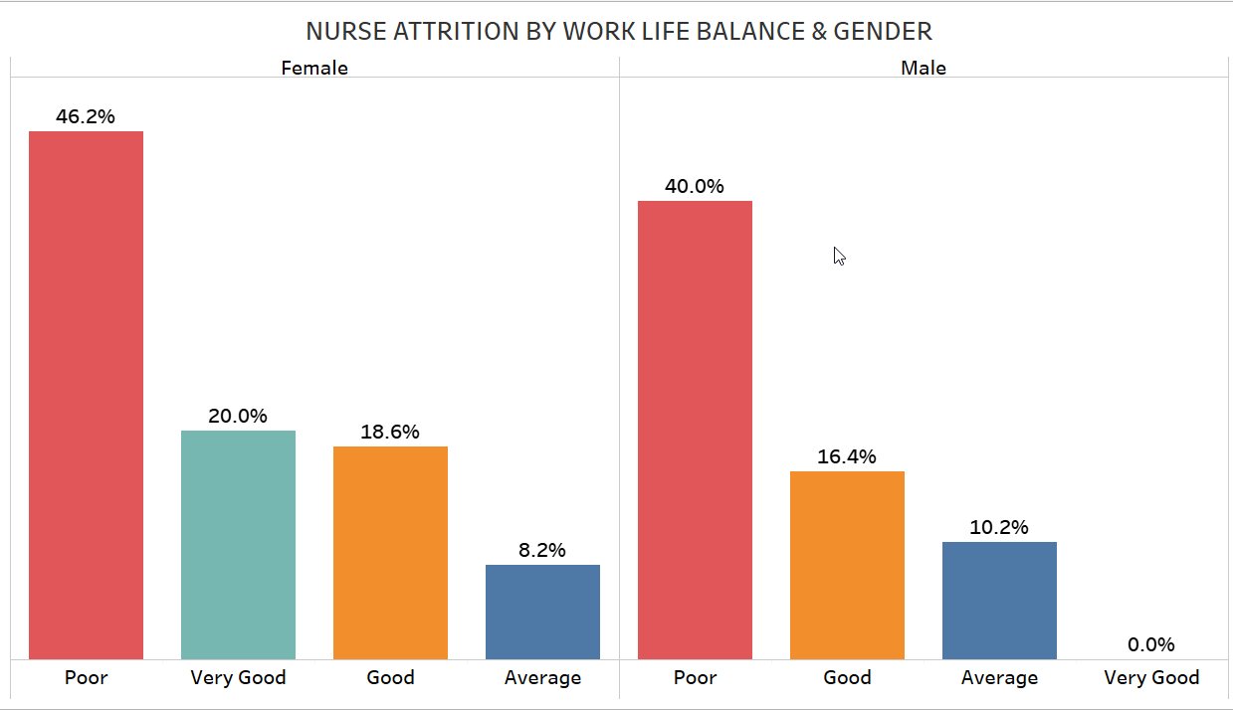
Analysis Findings:
Attrition Trends
. Observation:
Nurses with a poor work-life balance exhibit the highest attrition rates:
Female Nurses: 46.2%
Male Nurses: 40.0%.
Attrition is significantly lower for those with a very good work-life balance:
Female Nurses: 20.0%.
Insights:
Work-life balance is a critical factor in retaining nurses, with significant disparities between satisfaction levels.
Female nurses seem disproportionately affected by poor work-life balance, likely due to additional familial or societal responsibilities.
High-Risk Segments:
Female nurses with poor work-life balance.
Nurses not involved in their roles or dissatisfied with their environment.
Employees in undefined or unstructured job roles.
Key Drivers of Satisfaction:
Strong relationships with colleagues and management.
Defined roles, job involvement, and structured schedules.
Safe and resourceful work environments..

Slide 13
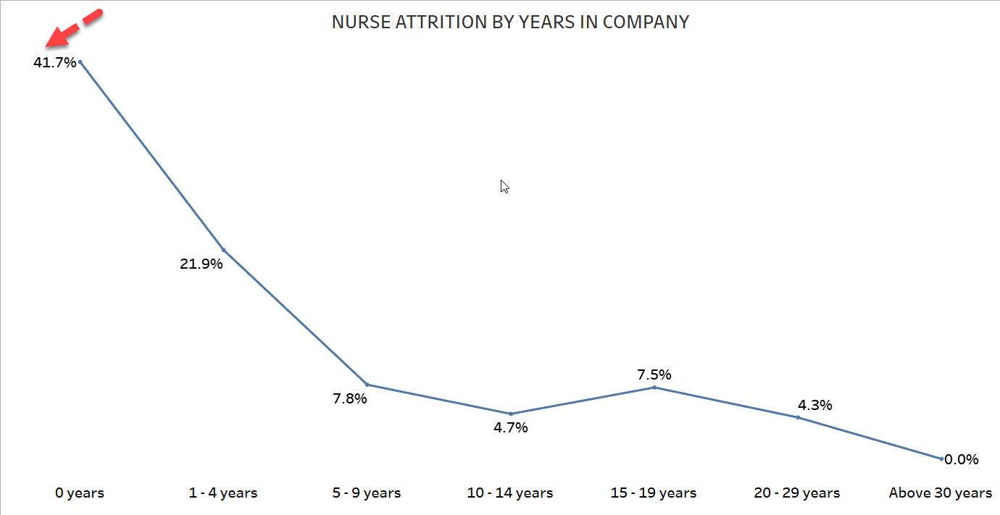
Observation:
The first year of employment sees the highest attrition rate (41.7%), a critical red flag.
Attrition rates decline sharply to around 6%-8% by years 3-10, then increase after 20 years (50%).
Insights:
Early-stage attrition is often linked to poor onboarding, lack of cultural fit, or unmet expectations.
Late-career attrition could be due to retirement, burnout, or a lack of incentives for long-tenured employees.
Introduce tailored retention initiatives for new hires and long-serving nurses, such as mentorship for early-stage employees and rewards for tenure milestones.

Slide 14
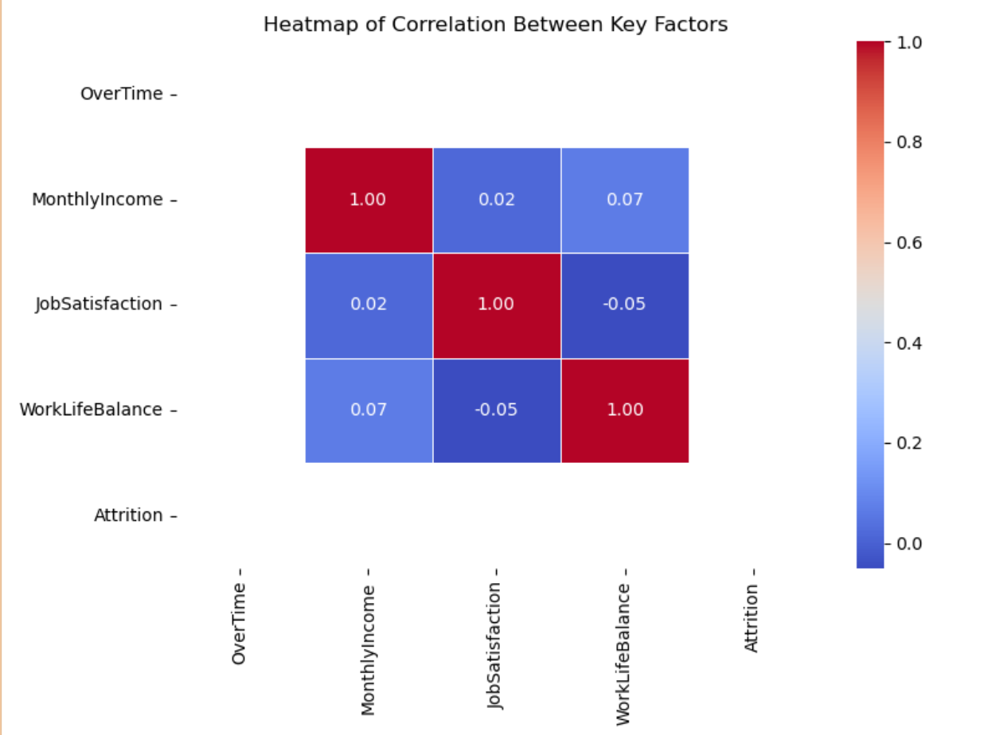
Root cause analysis
Primary Drivers:
Workload and burnout.
Compensation disparities.
Limited career growth.
Organizational culture and management practices.

Slide 15
Implementation Roadmap
3. Correlation Between Job Satisfaction and Attrition
Observation: Strong negative correlation.
Higher job satisfaction correlates with lower attrition.
Implication: Improving job satisfaction through engagement, recognition, and career development can significantly reduce nurse turnover.
4. Correlation Between Work-Life Balance and Attrition
Observation: Moderate negative correlation.
Better work-life balance correlates with lower attrition.
Implication: Policies supporting flexible schedules, mental health resources, and reduced overtime will enhance retention.
5. Interrelationships Among Factors
Workload and Job Satisfaction:
The weak negative correlation suggests that excessive workload might reduce job satisfaction, indirectly influencing attrition.
Compensation and Satisfaction:
A weak positive correlation indicates that financial incentives alone are insufficient to drive satisfaction and retention.
1. Correlation Between OverTime and Attrition
Observation: Positive correlation (moderate).
Nurses working overtime are more likely to leave the organization.
Implication: High workload and burnout contribute significantly to attrition. Addressing overtime policies is critical to improving retention.
2. Correlation Between Monthly Income and Attrition
Observation: Weak negative correlation.
Higher-income nurses have slightly lower attrition rates, but the relationship is not strong.
Implication: While compensation matters, other factors such as satisfaction and workload have a stronger impact on retention.

Slide 16
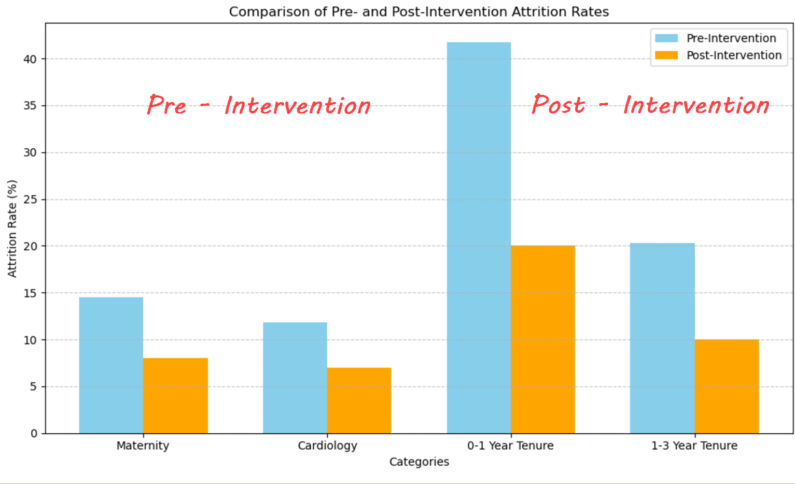
Proposed Retention Strategies
Strategies:
Reduce workload:
Implement equitable workload distribution.
Reduce overtime dependency.
Enhance wellness programs to support mental health.
Address compensation gaps:
Conduct salary benchmarking to ensure competitive pay.
Introduce retention bonuses for under-compensated staff.
Enhance career growth:
Develop structured career pathways for professional development.
Offer leadership training for high performers.
Strengthen Organizational Culture:
Train managers to build supportive relationships.
Promote work-life balance through flexible scheduling.

Slide 17
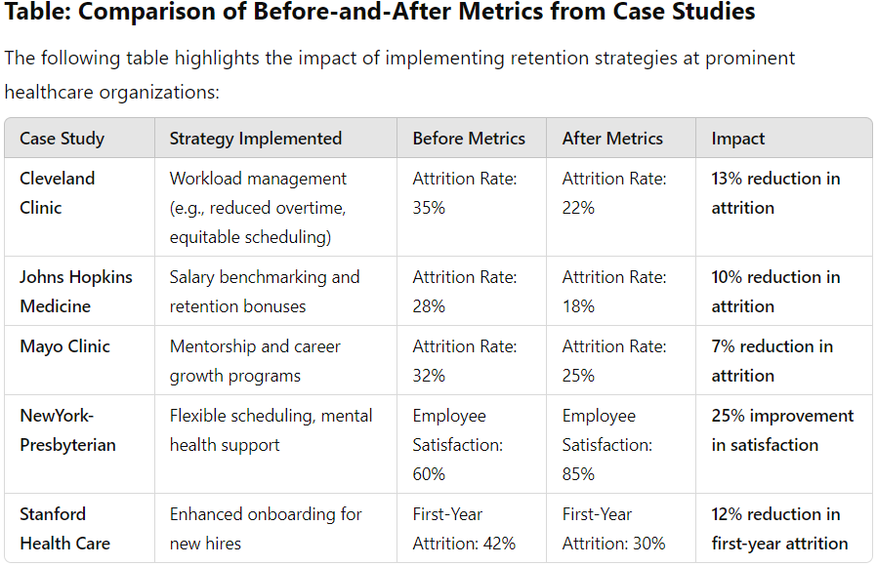
Case Studies
Examples of Success:
Cleveland Clinic: Reduced attrition by 22% through workload management.
Mayo Clinic: Increased retention by 25% via career development programs.

Slide 18
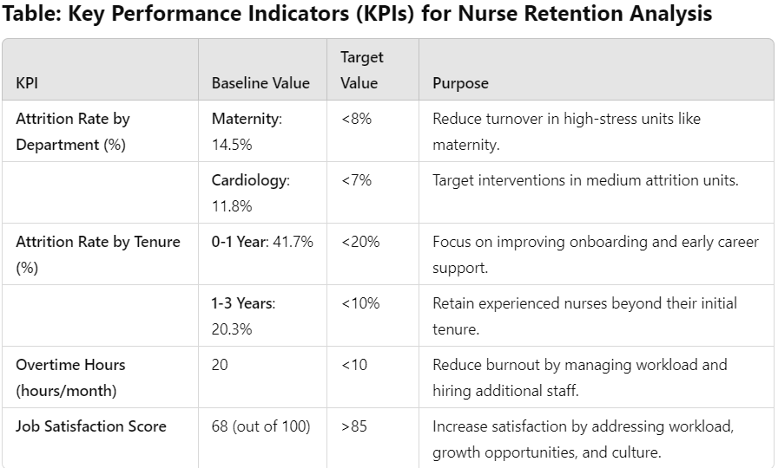
Monitoring and Evaluation Plan
Key Performance Indicators (KPIs):
Attrition rates by department and tenure.
Overtime hours and job satisfaction scores.
Monitoring Tools:
Power BI dashboards, employee surveys.

Slide 19
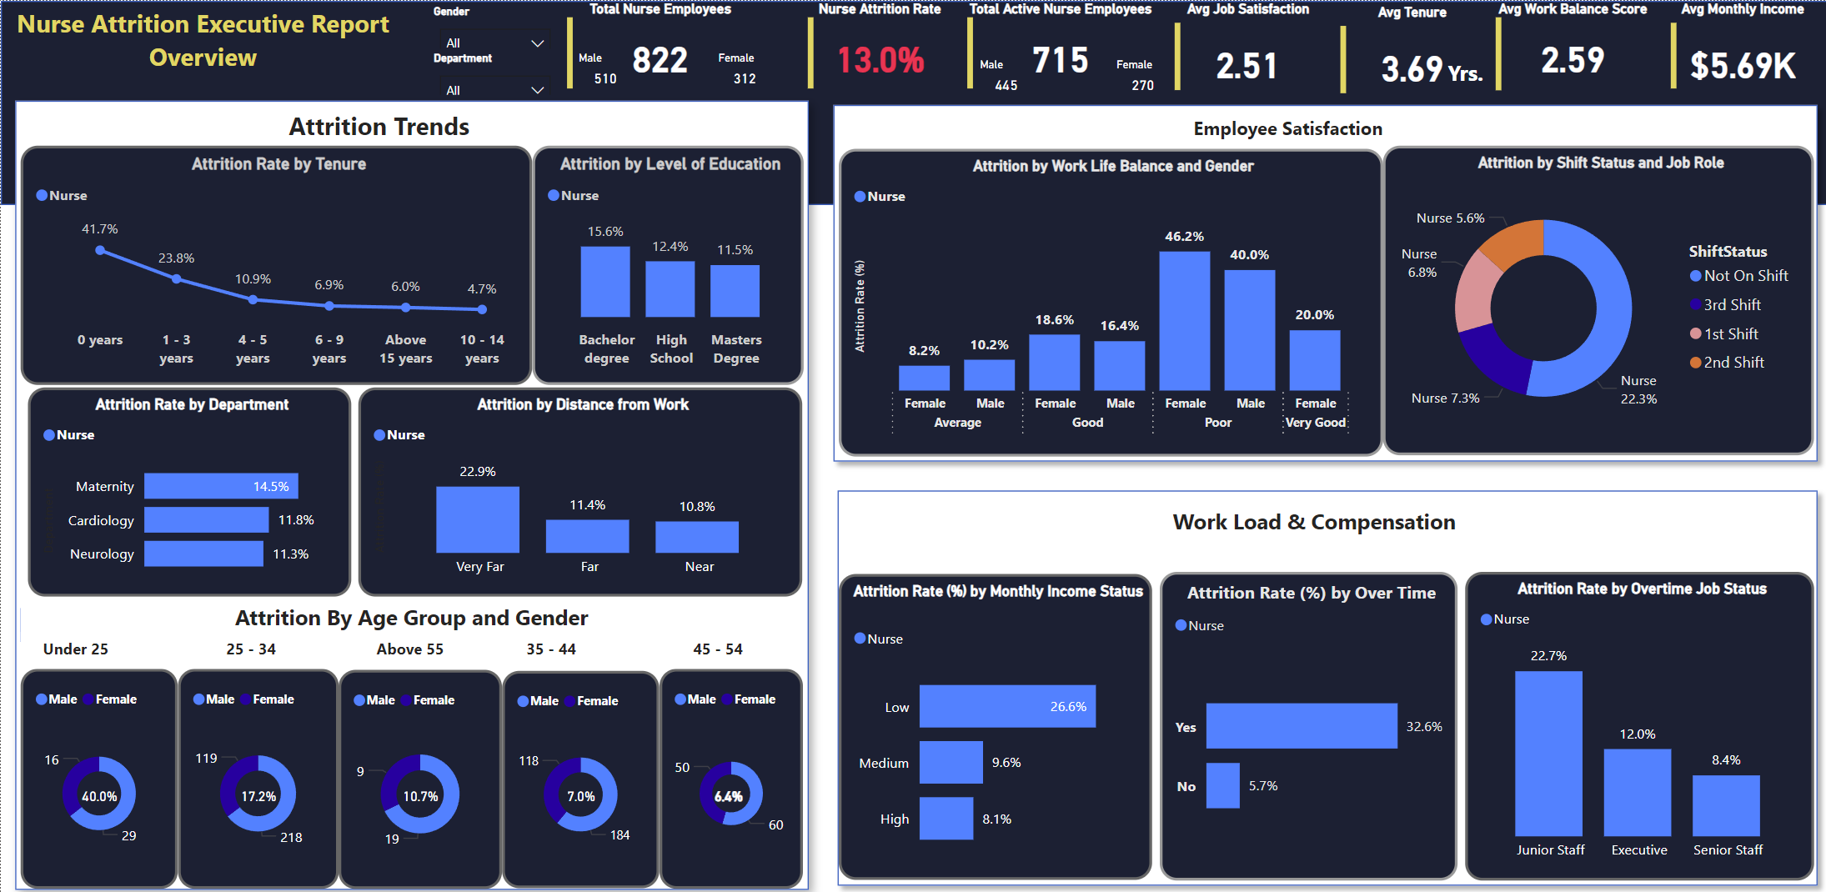
Dashboard

Slide 20
Implementation Roadmap
Short-Term Actions:
Address workload disparities through immediate staffing adjustments.
Enhance salary structures for low-income nurses.
Long-Term Actions:
Develop professional growth programs.
Implement wellness initiatives and managerial training.

Slide 21
Conclusion
Summary:
Attrition is driven by workload, compensation, and career satisfaction.
Proposed strategies are evidence-based and actionable.
Next Steps:
Finalize strategy implementation plan.
Begin short-term interventions and track outcomes.

Slide 22

Thank you
By
Augustine Ogbonnah
"Together, we can create a more supportive environment for our nurses, ensuring better outcomes for patients and staff alike."

